Slide 1

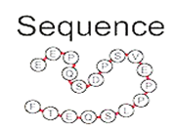

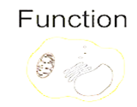
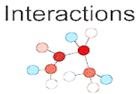

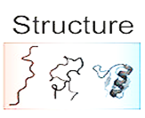
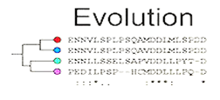
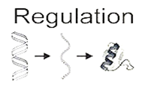
Prediction of
Protein Binding Regions in Disordered Proteins
Noureddine Ayad and Nancy Liodo M.
Bio-informatic and Modeling Master
07/03/2016

Slide 2
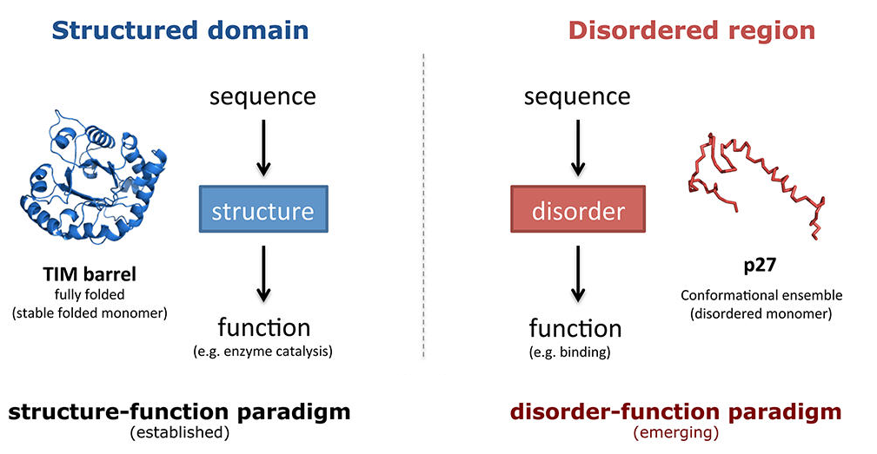
1-Introduction
2-Problematic
3-Algorithm
4-Methodes
5-Result
6-Discussion
7-Questions
Functional Regions In Proteins Can Either Be Structured Or Disordered
Notes:
Traditionally, protein function has been viewed as critically dependent on the well-deﬁned and folded three-dimensional structure of the polypeptide chain (left)-
this is based on the concept explaining the specificity of enzymes and actif sites have to adopt a specif 2D structure to recruit a typical ligand
So this classical concept implies that protein sequence deﬁnes---→ structure---→ which in turn determines function-
-this means that function can be inferred from the sequence and it’s structure.
A large amont of the proteome of any organism consists of polypeptide segments that are not form a deﬁned three-dimensional structure, but are nevertheless functional
These protein segments are referred to as intrinsically disordered regions -→ IDR (right panel)

Slide 3
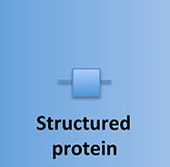

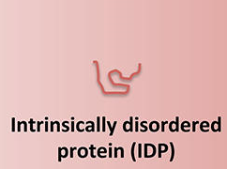
1-Introduction
2-Problematic
3-Algorithm
4-Methodes
5-Results
6-Discussion
7-Questions
What is?
  - Structured proteins
  IDR: Intrinsically Disordered Regions
  - IDP: Intrinsically Disordered Proteins
Notes:
1- Proteins without IDRs are called structured proteins,
and
2- These protein segments which disordered and do not present any 2D structure is named as -→ IDR
3-proteins with entirely disordered sequences that do not adopt any 3D structure are referred to as intrinsically disordered proteins (IDPs) OR ( IUP) unstructured
=> and hence their functionality arises in a diﬀerent manner as compared to the classical structured proteins
The majority of eukaryotic proteins are made up of both structured and disordered regions,and both are important for functions that a protein can have in a variety of cellular contexts

Slide 4

1-Introduction
2-Problematic
Why IDR and IDP can not have a structure ?
IDRs generally lack bulky hydrophobic amino acids, in fact they are unable to form the well-organized hydrophobic core that makes up a structured domaim.
Notes:
Because IDRs generally lack bulky hydrophobic amino acids, they are unable to form the well-organized hydrophobic core that makes up a structured domain
and hence their functionality arises in a diﬀerent manner as compared to the classical structure−function view of globular, structured proteins

Slide 5
1-Introduction
2-Problematic
Functional
Elements
Function
Structure
Various Classiﬁcations of Intrinsically Disordered Regions and Proteins
Sequence
Regulation
Proteins
Interaction
Biophysical
properties
Evolution
Notes:
A various classiﬁcations of intrinsically disordered regions and proteins have been put forward in the literature.
by the way they have been classified based on their:
Function: for example ,,,,,,,,,,,,,,,,,,,,,,,,,,,,,,,,,,,,,,,,,,,,,,,,,,,,,,,,,,,,,,,,,,,,,,,,,,,,,,,,,,,,,,,,,,,,,,,,,,,,,,,,,,,,,,,,,,,,,,,,,,,,,,,,,,,
functional elements,
structure,
sequence,
protein interactions,
evolution, regulation, and biophysical properties.

Slide 6
1-Introduction
2-Problematic
Why We interest of IDR and IDPs?
Characterization of unannotated and uncharacterized protein segments is expected to lead to the discovery of novel functions and leads us to discover new biology for example in understanding molecular mechanisms of diseases that are not yet fully understood

Slide 7

1-Introduction
2-Problematic
3-Algorithm
4-Methodes
5-Results
6-Discussion
7-Questions
?
Recognize a special class of disordered segments from the amino acid sequence, namely those that are capable of undergoing a disorder-to-order transition upon binding to a globular protein partner ➔ called MoRFs

Slide 8
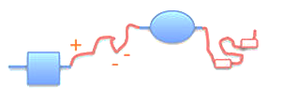
1-Introduction
2-Problematic
3-Algorithm
4-Methodes
5-Results
6-Discussion
7-Questions
The outline of the algorithm
The first criterion:
a given residue belongs to a long disordered region, and filters out globular domains.
2. The second criterion:
correspond to the isolated state, and it ensures that a residue is not able to form enough favorable contacts with its own local sequential neighbors to fold.
Notes:
The goal of the present work was to recognize a special class of disordered segments from the amino acid sequence, namely those that are capable of undergoing a disorder-to-order transition upon binding to a globular protein partner.
The essential feature of such binding regions is that they behave in a characteristically different manner in isolation than bound to their partner protein. In their free state, they behave as disordered proteins, existing as a highly flexible structural ensemble. In their bound state they usually adopt a rigid conformation, similar to regions within globular structures. This capability to behave in drastically different ways in different environments is targeted by our approach. We seek to identify segments in a generally disordered region that cannot form enough favorable intrachain interactions, however they have the capability to energetically gain by interacting with a globular partner protein. Our prediction is based on three properties.
1- a given residue belongs to a long disordered region, and filters out globular domains.
2-The second criterion corresponds to the isolated state and it ensures that a residue is not able to form enough favorable contacts with its own local sequential neighbors to fold, otherwise it would be prone to adopt a well defined structure on its own.

Slide 9
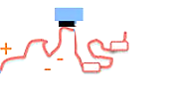
1-Introduction
2-Problematic
3-Algorithm
4-Methodes
5-Results
6-Discussion
7-Questions
The Outline Of The Algorithm
3. The third criterion:
tests the feasibility that a given residue can form enough favorable interactions with globular proteins upon binding. This basically ensures that there is an energy gain by interacting with globular regions.
Notes:
. The third criterion:
tests the feasibility that a given residue can form enough favorable interactions with globular proteins upon binding.
=> This basically ensures that there is an energy gain by interacting with globular regions,

Slide 10
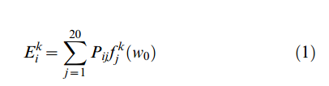
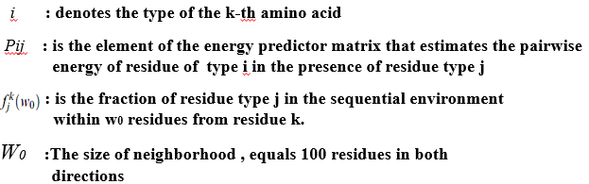
1-Introduction
2-Problematic
3-Algorithm
4-Methodes
5-Results
6-Discussion
7-Questions
The Outline Of The Algorithm
Using the fixed energy predictor matrix P from IUPred , the ANCHOR algorithm predicts the E interaction energy for each residue based on the following formula:

Slide 11

1-Introduction
2-Problematic
3-Algorithm
4-Methodes
5-Results
6-Discussion
7-Questions
The Outline Of The Algorithm
The disordered binding site prediction is based on 3 different scores:
1: To measure the tendency of the neighborhood of an amino acid for being disordered we use the IUPred algorithm and assign an Sk score to the k-th residue of the chain by averaging the IUPred scores in the
w1 neighborhood of the residue in question :
Notes:
The disordered binding site prediction is based on three different scores that are calculated with a slight modification of the original energy estimation scheme. The parameters of P_{ij} were taken directly from IUPred. The following three scores are assigned to each residue in a protein according to the above described criteria (1–3):

Slide 12
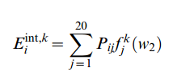
1-Introduction
2-Problematic
3-Algorithm
4-Methodes
5-Results
6-Discussion
7-Questions
The Outline Of The Algorithm
The disordered binding site prediction is based on 3 different scores:
2: We estimate the pairwise interaction energy the given residue may gain by forming intrachain contacts. This is done the exact same way as in IUPred using (1), only here the size of the considered neighborhood (w2) is left as a parameter and is set during the training of the predictor :
The smaller window size corresponds to more local behavior
Notes:
The disordered binding site prediction is based on three different scores that are calculated with a slight modification of the original energy estimation scheme. The parameters of P_{ij} were taken directly from IUPred. The following three scores are assigned to each residue in a protein according to the above described criteria (1–3):

Slide 13
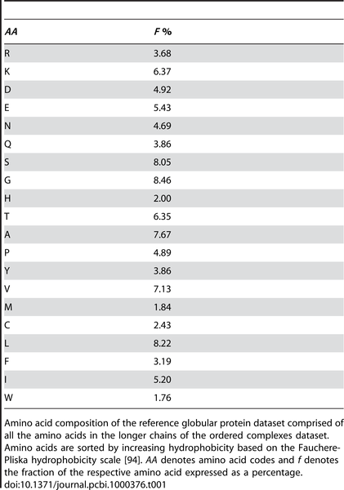

1-Introduction
2-Problematic
3-Algorithm
4-Methodes
5-Results
6-Discussion
7-Questions
The Outline Of The Algorithm
The disordered binding site prediction is based on 3 different scores:
3: The pairwise energy that the residue may gain by interacting with a globular protein is approximated using the average amino acid composition of globular proteins:
Table 1.
Reference amino acid composition of globular proteins.
Mészáros B, Simon I, Dosztányi Z (2009) Prediction of Protein Binding Regions in Disordered Proteins. PLoS Comput Biol 5(5): e1000376. doi:10.1371/journal.pcbi.1000376
http://journals.plos.org/ploscompbiol/article?id=info:doi/10.1371/journal.pcbi.1000376

Slide 14
1-Introduction
2-Problematic
3-Algorithm
4-Methodes
5-Results
6-Discussion
7-Questions
The Outline Of The Algorithm
By subtracting this energy from E ^{int,k}, one can estimate the energy that the residue may gain by interacting with a hypothetical globular protein compared to forming intrachain contacts

Slide 15

1-Introduction
2-Problematic
3-Algorithm
4-Methodes
5-Results
6-Discussion
7-Questions
The Outline Of The Algorithm
For the final prediction output, the energies are transformed into probability that expresses the ability of residue to in disordered binding site (P-value).
Notes:
For a binary classification residues with scores above 0.5 are predicted to be in a disordered binding site.
The final prediction is based on three different scores that combine local and global disorder tendency with sensitivity to the structural environmen

Slide 16
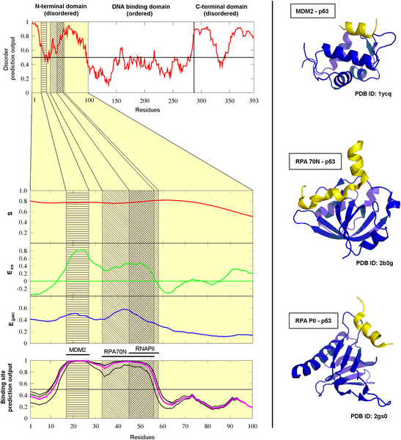
1-Introduction
2-Problematic
3-Algorithm
4-Methodes
5-Results
6-Discussion
7-Questions
Testing Of The Algorithm
Figure 1. The construction of the ANCHOR prediction method demonstrated on the N-terminal domain of human p53.
Mészáros B, Simon I, Dosztányi Z (2009) Prediction of Protein Binding Regions in Disordered Proteins. PLoS Comput Biol 5(5): e1000376. doi:10.1371/journal.pcbi.1000376
http://journals.plos.org/ploscompbiol/article?id=info:doi/10.1371/journal.pcbi.1000376

Slide 17
2-Aim of the
Study
5-Tests &
Results
6-llllllllll
7-Questions
1-Introduction
3-Algorithm
4-Methods
6- Conclusion
Three-fold Cross Validation
Testing subsets
Short Disordered Binding Sites (1/3)
Globular Proteins (1/3)
Disordered Proteins
Datasets
Training subsets
IUPred
Short Disordered Binding Sites (2/3)
Globular Proteins (2/3)
Monomeric globular protein dataset
ANCHOR
Random parameter sets
1 - (w₁, w₂, p₁, p₂, p₃)
2 - (w₁, w₂, p₁, p₂, p₃)
3 - (w₁, w₂, p₁, p₂, p₃)
…
144,000 - (w₁, w₂, p₁, p₂, p₃)
Energy predictor matrix
P_{ij}
S, E_{int} , E_{gain}
calculated for every protein in all datasets
Prediction based on their linear combination
True Positive Rate (TPR)
False Positive Rate (FPR)
Fraction of Disordered Proteins predicted to be binding site (F)
Evaluation of the parameter set
Notes:
Testing of the predictor was done by dividing both our negative and positive datasets (Globular proteins and Short disordered complexes) into three subsets, training the predictor on two of these and evaluating it on the remaining third one. This was done in all three possible combinations yielding three optimal parameter sets. The parameters calculated on the training sets are shown in Table 2 together with the respective True Positive Rates (TPR) and the fraction of the amino acids in disordered regions of the Disprot dataset predicted to be in disordered binding sites (F values). The optimal parameters were chosen to maximize the amount of correctly predicted disordered binding sites (TPR) while minimizing predicted binding sites in globular proteins (FPR) and also restricting predicted binding sites within disordered regions in general (F). The fact that the three parameter sets do not differ significantly implies that our method is robust.

Slide 18
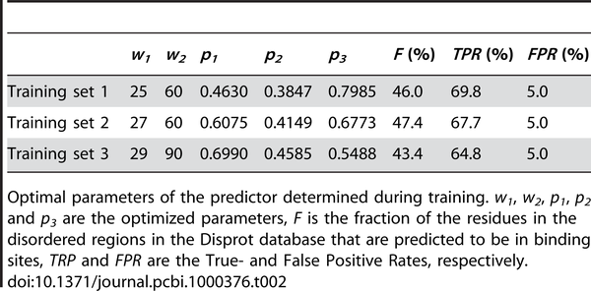
1-Introduction
2-Problematic
3-Algorithm
4-Methodes
5-Results
6-Discussion
7-Questions
Testing Of The Algorithm
Table 2.
Parameter and prediction accuracy values obtained during the optimization of ANCHOR.
Mészáros B, Simon I, Dosztányi Z (2009) Prediction of Protein Binding Regions in Disordered Proteins. PLoS Comput Biol 5(5): e1000376. doi:10.1371/journal.pcbi.1000376
http://journals.plos.org/ploscompbiol/article?id=info:doi/10.1371/journal.pcbi.1000376

Slide 19
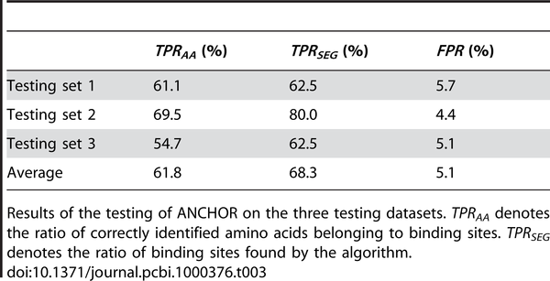
1-Introduction
2-Problematic
3-Algorithm
4-Methodes
5-Results
6-Discussion
7-Questions
Testing Of The Algorithm
Table 3. Prediction efficiency of ANCHOR evaluated on the testing datasets.
Mészáros B, Simon I, Dosztányi Z (2009) Prediction of Protein Binding Regions in Disordered Proteins. PLoS Comput Biol 5(5): e1000376. doi:10.1371/journal.pcbi.1000376
http://journals.plos.org/ploscompbiol/article?id=info:doi/10.1371/journal.pcbi.1000376

Slide 20
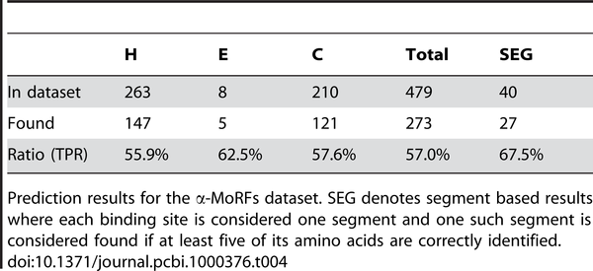
1-Introduction
2-Problematic
3-Algorithm
4-Methodes
5-Results
6-Discussion
7-Questions
Testing Of The Algorithm
Table 4. Prediction efficiency of ANCHOR evaluated on an independent dataset (α-MoRFs dataset).
Mészáros B, Simon I, Dosztányi Z (2009) Prediction of Protein Binding Regions in Disordered Proteins. PLoS Comput Biol 5(5): e1000376. doi:10.1371/journal.pcbi.1000376
http://journals.plos.org/ploscompbiol/article?id=info:doi/10.1371/journal.pcbi.1000376

Slide 21
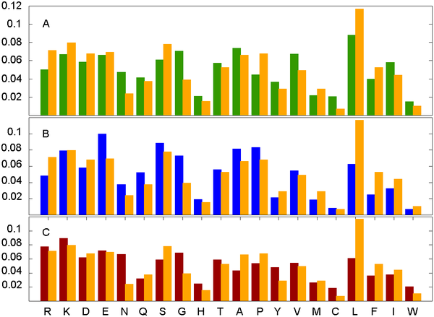
1-Introduction
2-Problematic
3-Algorithm
4-Methodes
5-Results
6-Discussion
7-Questions
Amino acid based evaluation of the predictor
Figure 3. The distinct amino acid composition of short disordered binding sites.
Mészáros B, Simon I, Dosztányi Z (2009) Prediction of Protein Binding Regions in Disordered Proteins. PLoS Comput Biol 5(5): e1000376. doi:10.1371/journal.pcbi.1000376
http://journals.plos.org/ploscompbiol/article?id=info:doi/10.1371/journal.pcbi.1000376

Slide 22
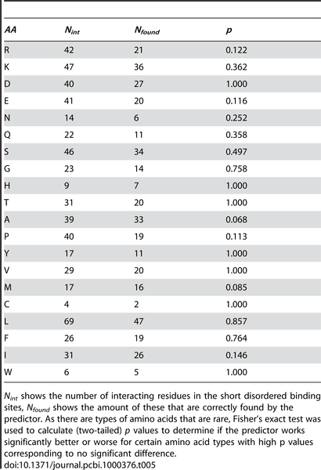
1-Introduction
2-Problematic
3-Algorithm
4-Methodes
5-Results
6-Discussion
7-Questions
Amino acid based evaluation of the predictor
Table 5. The independence of the efficiency of ANCHOR from the amino acid composition of the binding sites.
Mészáros B, Simon I, Dosztányi Z (2009) Prediction of Protein Binding Regions in Disordered Proteins. PLoS Comput Biol 5(5): e1000376. doi:10.1371/journal.pcbi.1000376
http://journals.plos.org/ploscompbiol/article?id=info:doi/10.1371/journal.pcbi.1000376

Slide 23
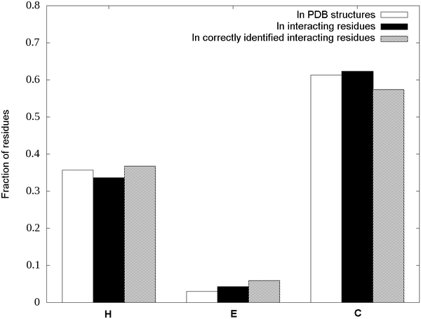
1-Introduction
2-Problematic
3-Algorithm
4-Methodes
5-Results
6-Discussion
7-Questions
Secondary Structures And The Efficiency Of ANCHOR
However assessing the difference of the distributions of secondary structures in interacting residues and in the subset identified correctly by ANCHOR shows that this difference is not statistically significant at a 5% level,
Figure 4. Secondary structure distributions in the short disordered binding site dataset.
Mészáros B, Simon I, Dosztányi Z (2009) Prediction of Protein Binding Regions in Disordered Proteins. PLoS Comput Biol 5(5): e1000376. doi:10.1371/journal.pcbi.1000376
http://journals.plos.org/ploscompbiol/article?id=info:doi/10.1371/journal.pcbi.1000376

Slide 24
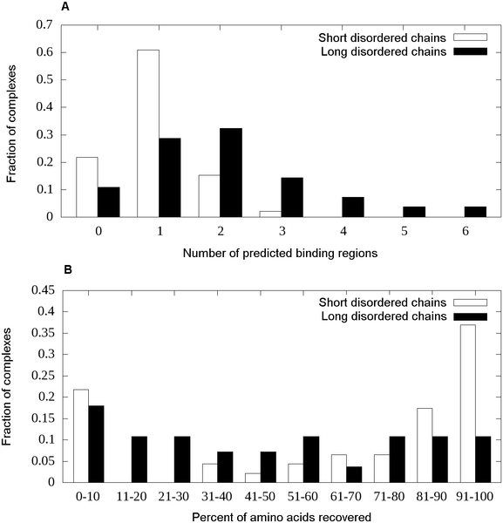
1-Introduction
2-Problematic
3-Algorithm
4-Methodes
5-Results
6-Discussion
7-Questions
Testing On Long Disordered Regions
Figure 5. Prediction accuracies and segmentation for the short and long disordered binding sites.
Mészáros B, Simon I, Dosztányi Z (2009) Prediction of Protein Binding Regions in Disordered Proteins. PLoS Comput Biol 5(5): e1000376. doi:10.1371/journal.pcbi.1000376
http://journals.plos.org/ploscompbiol/article?id=info:doi/10.1371/journal.pcbi.1000376

Slide 25
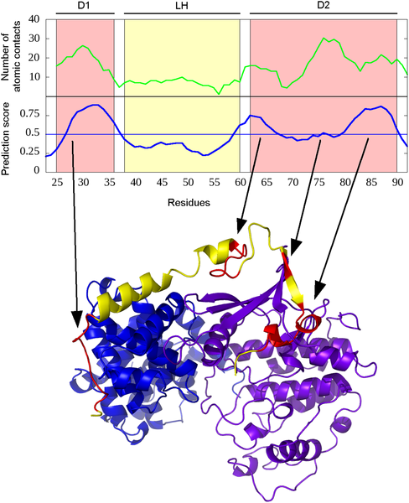
1-Introduction
2-Problematic
3-Algorithm
4-Methodes
5-Results
6-Discussion
7-Questions
Testing On Long Disordered Regions
Figure 6. ANCHOR prediction for human p27.
Mészáros B, Simon I, Dosztányi Z (2009) Prediction of Protein Binding Regions in Disordered Proteins. PLoS Comput Biol 5(5): e1000376. doi:10.1371/journal.pcbi.1000376
http://journals.plos.org/ploscompbiol/article?id=info:doi/10.1371/journal.pcbi.1000376

Slide 26
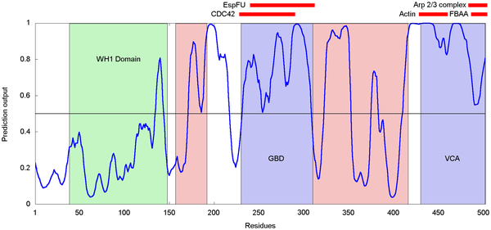
1-Introduction
2-Problematic
3-Algorithm
4-Methodes
5-Results
6-Discussion
7-Questions
Wiskott-Aldrich Syndrome Protein (WASp)
Figure 7. ANCHOR prediction for human WASp.
Mészáros B, Simon I, Dosztányi Z (2009) Prediction of Protein Binding Regions in Disordered Proteins. PLoS Comput Biol 5(5): e1000376. doi:10.1371/journal.pcbi.1000376
http://journals.plos.org/ploscompbiol/article?id=info:doi/10.1371/journal.pcbi.1000376

Slide 27
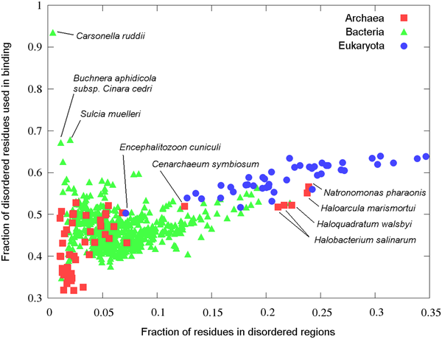
1-Introduction
2-Problematic
3-Algorithm
4-Methodes
5-Results
6-Discussion
7-Questions
Complete Proteome Scans
Figure 8. Fraction of disordered and disordered binding site residues in complete proteomes.
Mészáros B, Simon I, Dosztányi Z (2009) Prediction of Protein Binding Regions in Disordered Proteins. PLoS Comput Biol 5(5): e1000376. doi:10.1371/journal.pcbi.1000376
http://journals.plos.org/ploscompbiol/article?id=info:doi/10.1371/journal.pcbi.1000376

Slide 28
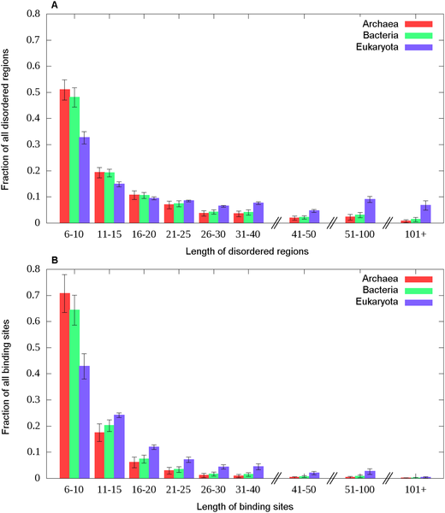
1-Introduction
2-Problematic
3-Algorithm
4-Methodes
5-Results
6-Discussion
7-Questions
Complete Proteome Scans
Figure 9. Length distribution of disordered and disordered binding sites in complete proteomes.
Mészáros B, Simon I, Dosztányi Z (2009) Prediction of Protein Binding Regions in Disordered Proteins. PLoS Comput Biol 5(5): e1000376. doi:10.1371/journal.pcbi.1000376
http://journals.plos.org/ploscompbiol/article?id=info:doi/10.1371/journal.pcbi.1000376

Slide 29

Questions

Slide 30
1-Introduction
2-Classification
Databases of Intrinsically Disordered Regions and Proteins
DisProt dataBase , http://www.disprot. org/
The IDEAL database (http://www.ideal.force.cs.is.nagoya-u. ac.jp/IDEAL/)
MobiDB database (http://mobidb.bio.unipd.it/)
pE-DB database (http://pedb.vib.be/)
The Database of Disordered Protein Prediction(D2P2, http://d2p2.pro/)
Notes:
Several resources exist that collect experimental or computational information on disordered regions in proteins.

Slide 31
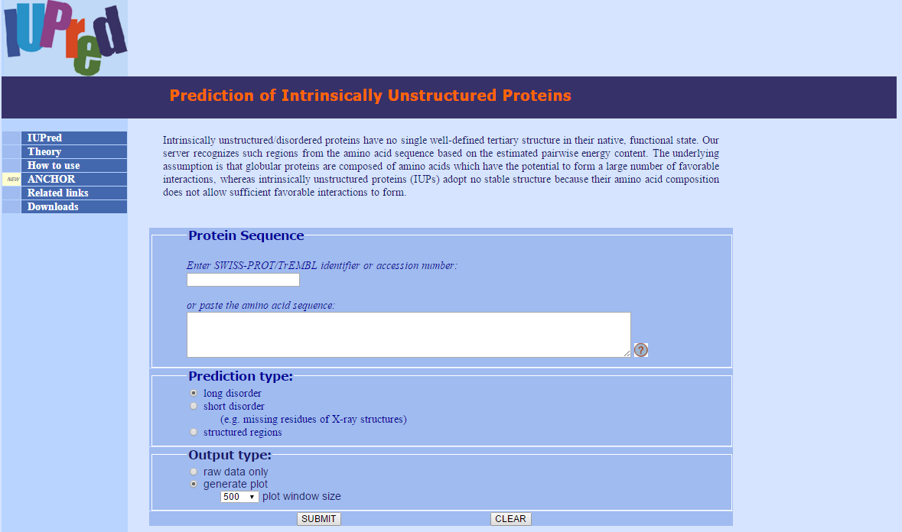
1-Introduction
2-Classification
Prediction of Intrinsically Disordered Regions and Proteins
Notes:
Predicting disordered regions from amino acid sequence allows the analysis of disordered proteins at a genome-wide scale and provides initial hypotheses about the presence of structural disorder in individual proteins.
- A large number of prediction methods have been developed and are regularly bench marked as part of the Critical Assessment of Techniques for Protein Structure Prediction (CASP)
-Disorder prediction based directly on sequence properties IUPRED

Slide 32
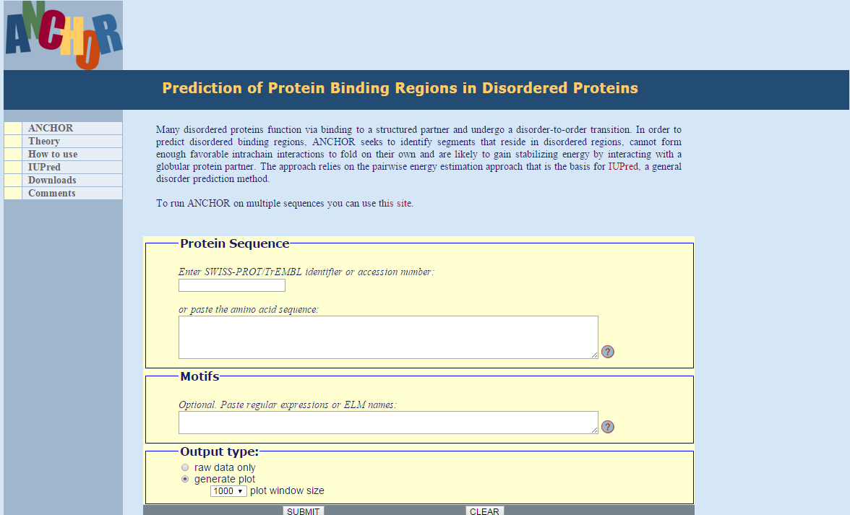
1-Introduction
2-Classification
Disordered Binding Site Prediction Method ANCHOR Proteins
Notes:
Predicting disordered regions from amino acid sequence allows the analysis of disordered proteins at a genome-wide scale and provides initial hypotheses about the presence of structural disorder in individual proteins.
- A large number of prediction methods have been developed and are regularly bench marked as part of the Critical Assessment of Techniques for Protein Structure Prediction (CASP)
-Disorder prediction based directly on sequence properties IUPRED

Slide 33
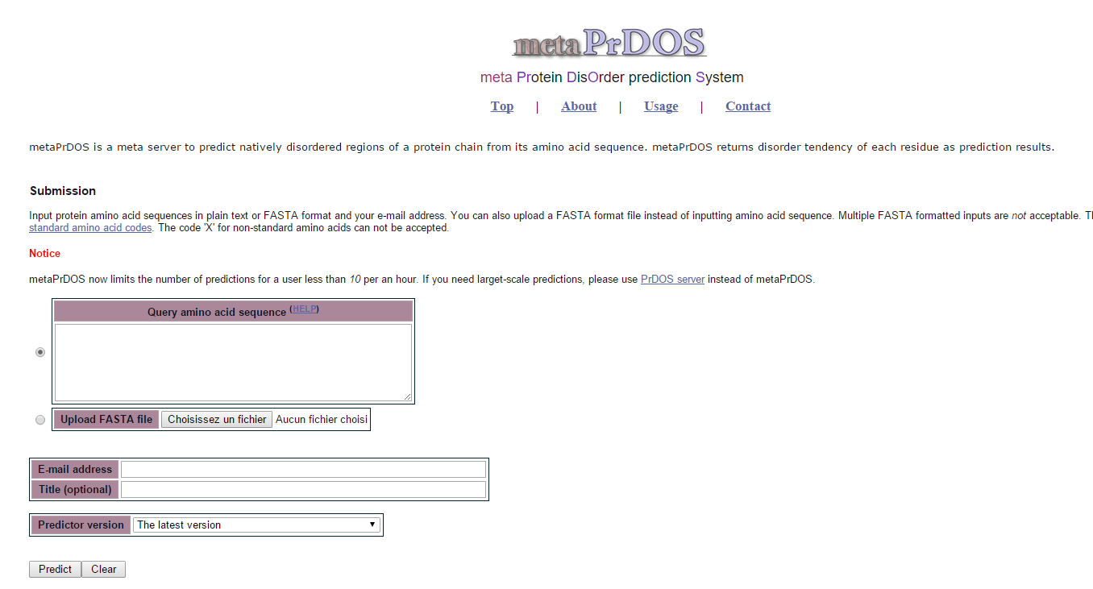
1-Introduction
2-Classification
Prediction of Intrinsically Disordered Regions and Proteins
Notes:
Meta-predictors that combine several individually successful disorder prediction methods have been developed more recently, resulting in increases in prediction accuracy.407 For instance, metaPrDOS413 and MFDp414 both apply SVM-based machine learning to the results of a number of individual prediction methods to arrive at a ﬁnal score

